Slide 1

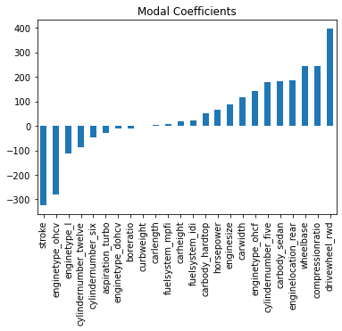
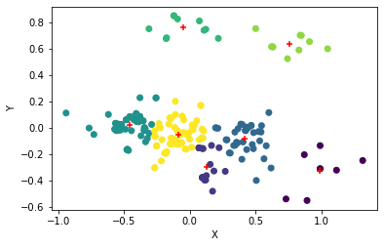
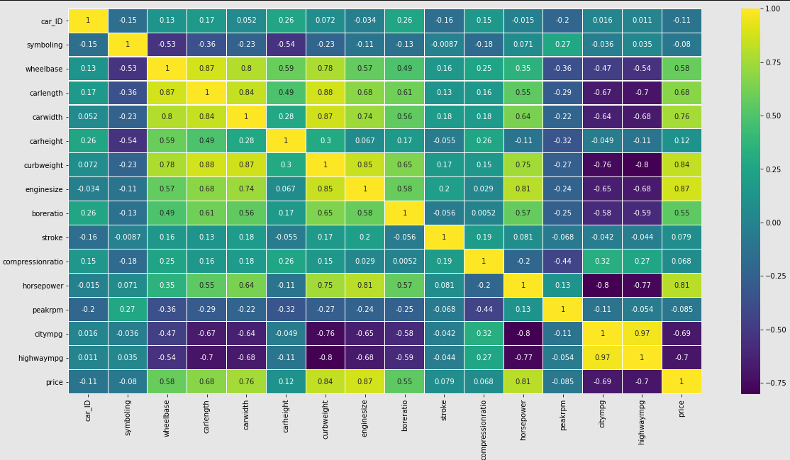
Car Price Prediction
Sri Sudheera Chitipolu
S538422@nwmissouri.edu
Interesting Relationship: There is huge correlation between price and engine size and next price and car weight, car length, car weight, wheel base and boreratio.
But price and engine size are weekly correlated with highwaympg.
From heat map we can observe that citympg, highwaympg, peakrmp, symboling and car Id are negatively correlated to price. So we can consider other features to predict.
Results
Linear | RBF | Polynomial | Sigmoid
Accuracy is 0.9230769230769231 | Accuracy is 0.7972027972027972 | Accuracy is 0.8321678321678322 | Accuracy is 0.20279720279720279
Precision is 0.9235617323852616 | Precision is 0.8094985985674246 | Precision is 0.8404354266423232 | Precision is 0.14564777327935222
Sensitivity is 0.9230769230769231 | Sensitivity is 0.797202797202797 | Sensitivity is 0.8321678321678322 | Sensitivity is 0.20279720279720279
F1 is 0.9228563567787569 | F1 is 0.7795675084883028 | F1 is 0.8307458507275668 | F1 is 0.16863228304875902
For understanding pricing dynamics of the new market in the different cars for business growth, we will predict the car’s prices depending on different independent variables. Several factors, including mileage, make, model, etc. can influence the actual worth of a car. From the perspective of a seller, it is also a dilemma to price a car appropriately. Based on existing data, the aim is to use machine learning algorithms to develop models for predicting car prices.
Learning Algorithm | R Square
Linear Regression | 85%
Ridge Regression | 82%
Lasso Regression | 86%
Elastic Net Regression | 76%
Dataset and Pre-Processing
Methodology
After rechecking the correlation for clustering, found car weight and engine size are most correlated features through PCA. Got 6 clusters.
There are 13 outliners which are removed using local outliner detector by which we got 21% AMSE –linear Reg.
For this project, we are using the dataset of car prices of different cars from United States, available on Kaggle[1]. The features available in this dataset are Mileage, Car Name, Model, Fuel type, Aspiration, etc.
Drop Unnecessary Columns: Car ID, car name does not affect the price.
Label Encoding: Because of huge dataset performed label encoding on categorical data.
We utilized several classic and state-of-the-art methods, including ensemble learning techniques, with a 70-30 split on test and training data.
Linear Regression: Linear Regression model is used on dataset and evaluated the model with mean square error and R square and also improved the model performance by choosing other regressions like Ridge Regression, Lasso Regression, Elastic Net Regression
Classification: Decision Tree and SVM with different kernels are used on dataset and evaluated model with cross validation and also performed evaluation on test set using SVM model with different kernels. Used SVM Kernels are
Linear, RBF, Polynomial, Sigmoid
Random Forest To account for the large number of features in the dataset used one of the ensemble learnings called random forest with random forest regressor.
Anomalous Data: Performed all outliners detectors methods to know about all anomalous data. Methods are: Isolation Forest, Minimum Covariance Determinant, Local Outlier Factor, One-Class SVM
Elastic net regression is working very well, because R square value decreased and feature coefficient values also performed good way rather than focusing only one feature, now most of the features of dataset are important.
Future Work
We plan to utilize Artificial Neural Networks to improve our prediction performance while avoiding overfitting. In addition to this, we shall tune Decision-Tree parameters like the number of trees, depth, etc. and sub-sample data points.
Decision Tree | 99%
Random Forest | 98%
References
Among all kernels Linear kernel having best results followed by polynomial kernel. Also in test evaluation linear and polynomial kernel gave best accuracy values.
So overall linear kernel SVM gave best accuracy values.
https://www.kaggle.com/hellbuoy/car-price-prediction
2. N. Monburinon et al "Prediction of prices for used car by using regression models," ICBIR 2018, Bangkok, 2018, pp. 115-119.

